Slide 1
Predicting Weekly Infection Hotspots in Counties
Presented by: Victoria Capobianco, Caroline Otten, Joshua Rotuna
May 3, 2021

Slide 2
Agenda:
Introduction
Predictive Question & Justification
Literature Review
Domain Understanding
Data Description & Model Planning
Data Source & Descriptive Statistics
Model Assumptions & Performance Criteria
Individual Models & Justification
Best Model & Results
Models Rationale
Best Model Performance
Results

Slide 3
I. Introduction

Slide 4
Predictive Question
Can we predict if a county will be deemed an infection hotspot?
What features play a role in determining if a county is a hotspot or not?

Slide 5
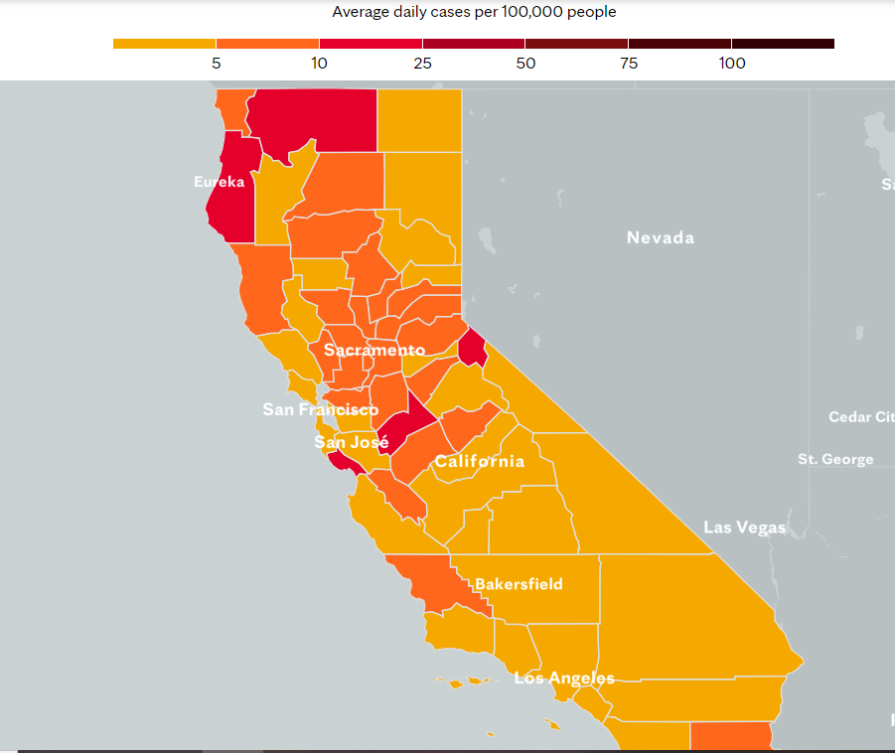
Research Justification
Current hotspot data based solely on number of cases
Our goal: Go beyond tracking the virus by analyzing a holistic picture of infection and areas it affects through predictive modeling
Weekly prediction allows affected area to prepare and take necessary precautions

Slide 6
Literature Review
An Efficient COVID-19 Prediction Model Validated with the Cases of China, Italy and Spain: Total or Partial Lockdowns? Journal of Clinical Medicine, 2020
Verhulst Equation
Measures infection as function of time
Initial infected population, total # of infected people, and growth rate
Data from China, Italy, and Spain
Detecting COVID-19 infection hotspots in England using large-scale self-reported data from a mobile application: a prospective, observational study. Lancet Public Health, 2020
Self-reported data from users of the COVID Symptom Study app
Logistic Regression model based on symptoms and test data to estimate rapid case increases

Slide 7
Domain Understanding
Business Stakeholders:
Government organizations
Hospitals, healthcare workers
Non-essential & small businesses
Schools
Difficulty in assessing cost-benefit analysis of lockdowns & hotspots
Ryan Bourne, CATO Institute
Uncertainty & Assessment of subjective values
Statistical value of a life and long-term effects
Harvard economists estimates COVID cost the US $16 trillion
Lost economic output
Premature deaths
Long-term disability
Mental health impacts

Slide 8
II. Data & Models

Slide 9
Dataset Info
Feature Selection
Population Density
Population
Median Age
Sum of Per Capita Income
White % of Population
Black %. Of Population
Indian Native % of Population
Asian % of Population
Hawaiian Pacific Islander % of Population
Other Race % of Population

Slide 10
Descriptive Stats
Population Statistics
Avg White Population | 72.6%
Avg Black Population | 3.3%
Avg Indian Population | 1.2%
Avg Asian Population | 8.8%
Avg Hawaiian Population | 0.31%
Average Age | 39.1
Average Population | 679,961
Average Population Density | 389/SqMi
56 counties
2700 Records
18 columns
Source: California Open Data Portal

Slide 11
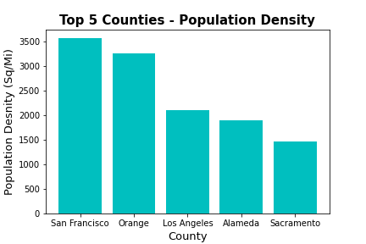
Exploratory Statistics
Most Populated Counties:
Los Angeles
San Diego
Orange County
Least Populated Counties:
Modoc
Trinity
Mono County

Slide 12

Assumptions
Populations Remained Constant
20% hospitalization rate
25% Rule → Hotspot

Slide 13
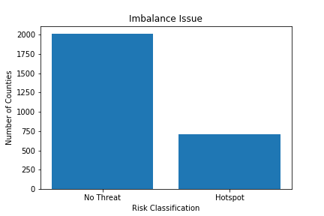
Class Imbalance Issue
75%: “No Threat”
25%: “Hotspot”
Used Random Sample from Majority Class

Slide 14
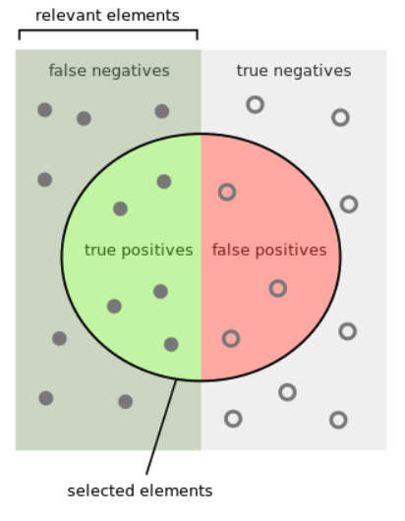
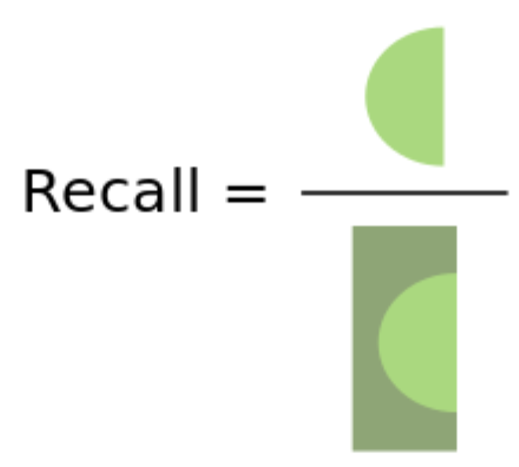
Performance Criteria
Emphasis on Recall
Evaluates Missed Positives

Slide 15

Model Choices
KNN Model
Logistic Regression
Decision tree
Notes:
-compare results to prior probability
-how much lift we are getting

Slide 16
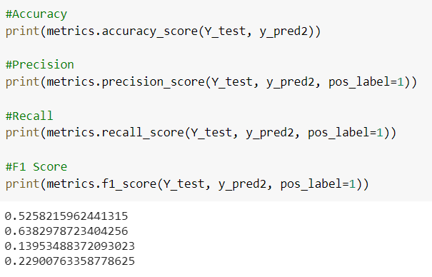
Logistic Regression
Target class Binary
Independent variables are continuous
Hyperparameters:
solver = liblinear
C=1.0, random_state = 99

Slide 17
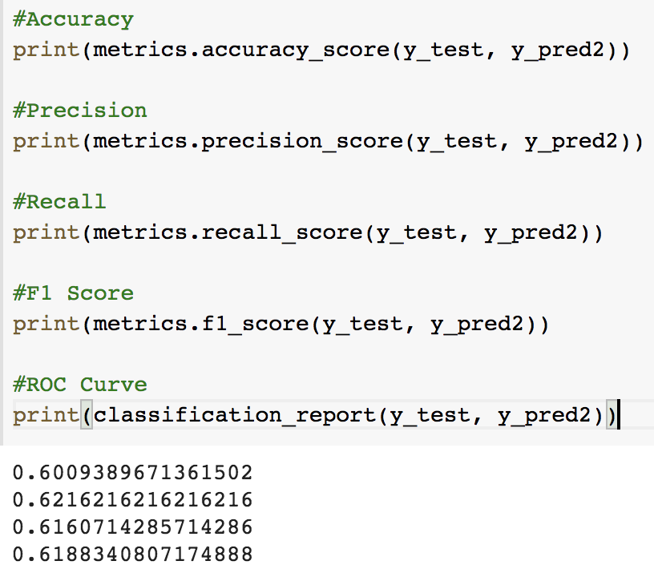
KNN Model
Classifies using closest neighbors
hyperparameters:
algorithm='ball_tree', leaf_size=30, metric='minkowski', metric_params=None, n_jobs=None, n_neighbors=25, p=2, weights='distance'

Slide 18

Decision Tree
Inputs:
Population density
Average Age
Per Capita Income
Demographic Percentages
Prediction: Hotspot or No Threat

Slide 19
III. Final Model & Results

Slide 20
Final Results
0.67
0.72
0.68
0.7
Accuracy
Recall
# of correct decisions/total # of decisions
True positive/(true positive + false negative)
Precision
F1 score
True positive/(true positive + false positive)
(2*Precision*Recall)/(Precision + Recall)

Slide 21
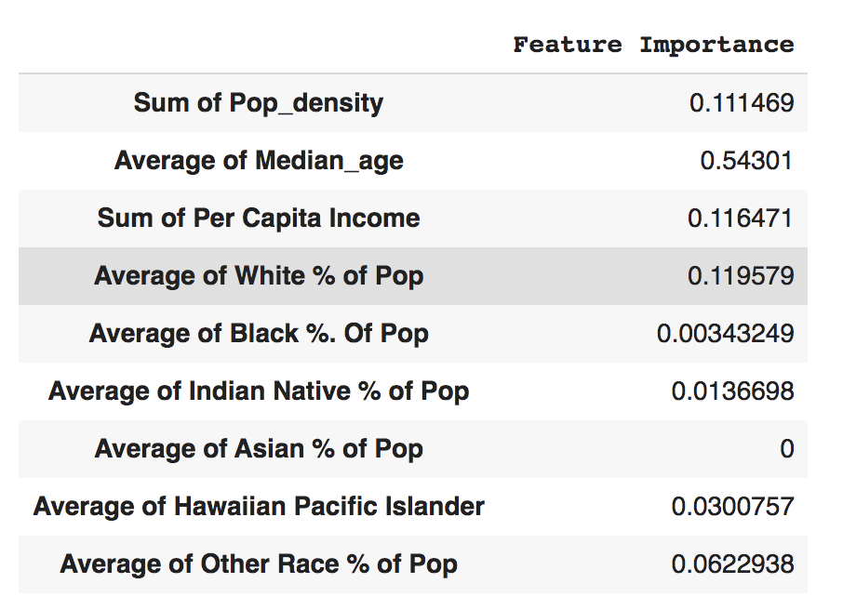
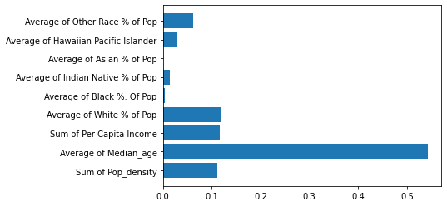
Feature Importance Results

Slide 22
Limitations
Future opportunities
Missing data from certain counties
Missing data on number of hospital beds available
Difficult to define what is considered a “hotspot”
Combine covid data with influenza data
Include additional features, such as percent of population with health insurance or percent of population above 65
Split label column into 3 categories, low, mild, and hotspot

Slide 23
Thank you!
Questions?

Slide 24
Sources
https://news.harvard.edu/gazette/story/2020/11/what-might-covid-cost-the-u-s-experts-eye-16-trillion/#:~:text=A%20pair%20of%20Harvard%20economists,and%20contact%20tracing%20that%20would
https://www.cato.org/blog/cost-benefit-analysis-lockdown-very-difficult-do-well
https://www.mdpi.com/2077-0383/9/5/1547
https://doi.org/10.1016/S2468-2667(20)30269-3
https://data.census.gov/cedsci/table?q=United%20States&t=-00%20-%20All%20available%20races%3AAge%20and%20Sex%3AHealth%20Insurance%3ARace%20and%20Ethnicity&g=0400000US06,06.050000&y=2019&tid=ACSSPP1Y2019.S0201&hidePreview=true
https://data.ca.gov/dataset/covid-19-time-series-metrics-by-county-and-state/resource/1be1e43c-b4b2-4002-afb6-340bbcc85bb
https://www.ncbi.nlm.nih.gov/pmc/articles/PMC7756168/

